Slide 1
Internship Report
At KANINI Software, Sholinganallur, Chennai
From October 2023 to December 2023
Ananth T A

Slide 2
Index
Internship Timeline
Problem Statement(s)
Solution Framework Overview
Task 1: Noshow Classification
Task 2: Appointment Time Prediction
Task 3: Stock Price Prediction
Model Deployment
Challenges and Limitations
Scope for Improvement
Learnings and Takeaways
Conclusion

Slide 3
Internship Timeline
Week 1-2
Week 3-4
Week 4-5
Week 6
Task 1 Development and Deployment
Task 2: Development and Deployment
Task 3: Development and deployment
Combined deployment and documentation

Slide 4
Problem Statement (s):
Task 1:
Given a dataset of clinic visits of a group of clinics, predict if a particular patient will appear for their appointment or not
Task 2:
Given a dataset of clinic visits of a group of clinics, predict at what time the patient will appear for their appointment
Task 3:
Given a dataset of the trends of a particular stock from 2015 to 2023, predict the Highest, Lowest and Closing price at any given date

Slide 5
Solution Framework Overview

Slide 6
Solution Framework Overview
Dataset Overview
Model Deployment
Model Training, Testing and Validation
Preprocessing
Exploratory Data Analysis

Slide 7
Tools Used:
All processing was done locally in python, via Visual Studio Code and relevant extensions.
Data Overview – Jupyter Notebook, Pandas
Exploratory Data Analysis - Pandas, Seaborn, Matplotlib
Preprocessing - Jupyter Notebook, Pandas, Scikit Learn
Model Training, Testing and Validation – Scikit Learn
Model Deployment – Joblib, Flask, HTML, CSS, JavaScript

Slide 8
Task 1: Noshow Classification

Slide 9
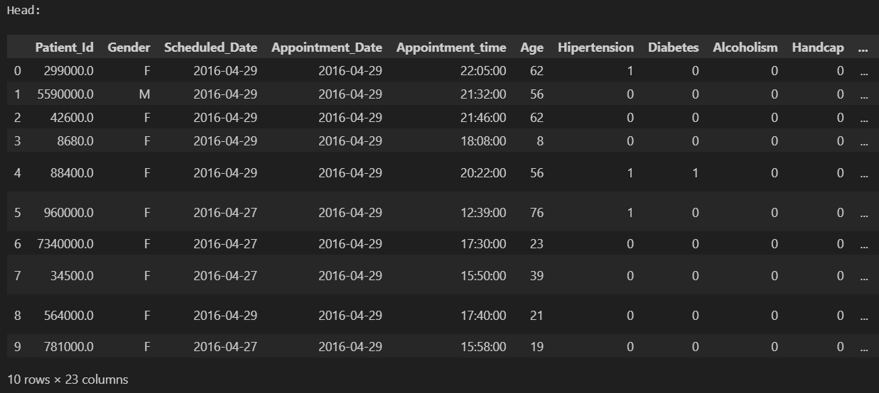
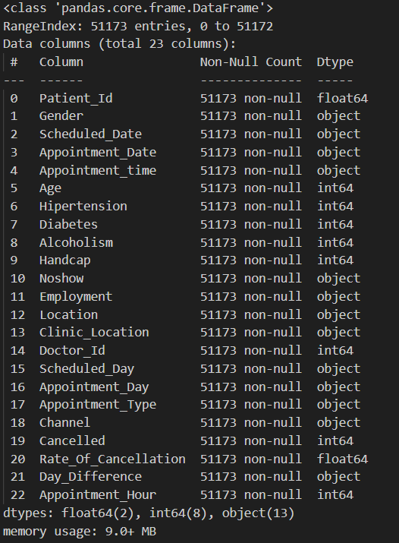
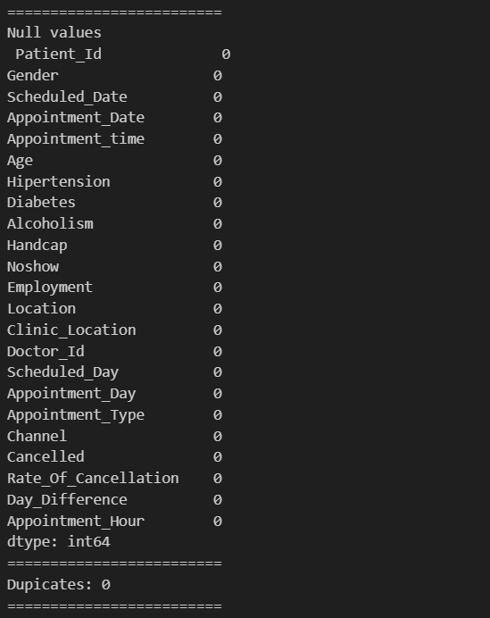
Noshow Classification
Understanding the dataset:
Let us take a cursory glance at our dataset

Slide 10
From the above overview of the dataset, we can see that:
There are 23 columns and 51173 entries.
Most columns are non-numerical, non-ordinal and have no duplicates or null entries.
Mean age is 36, 20% of patients have hypertension, 6% have diabetes, and 3% have alcoholism.

Slide 11
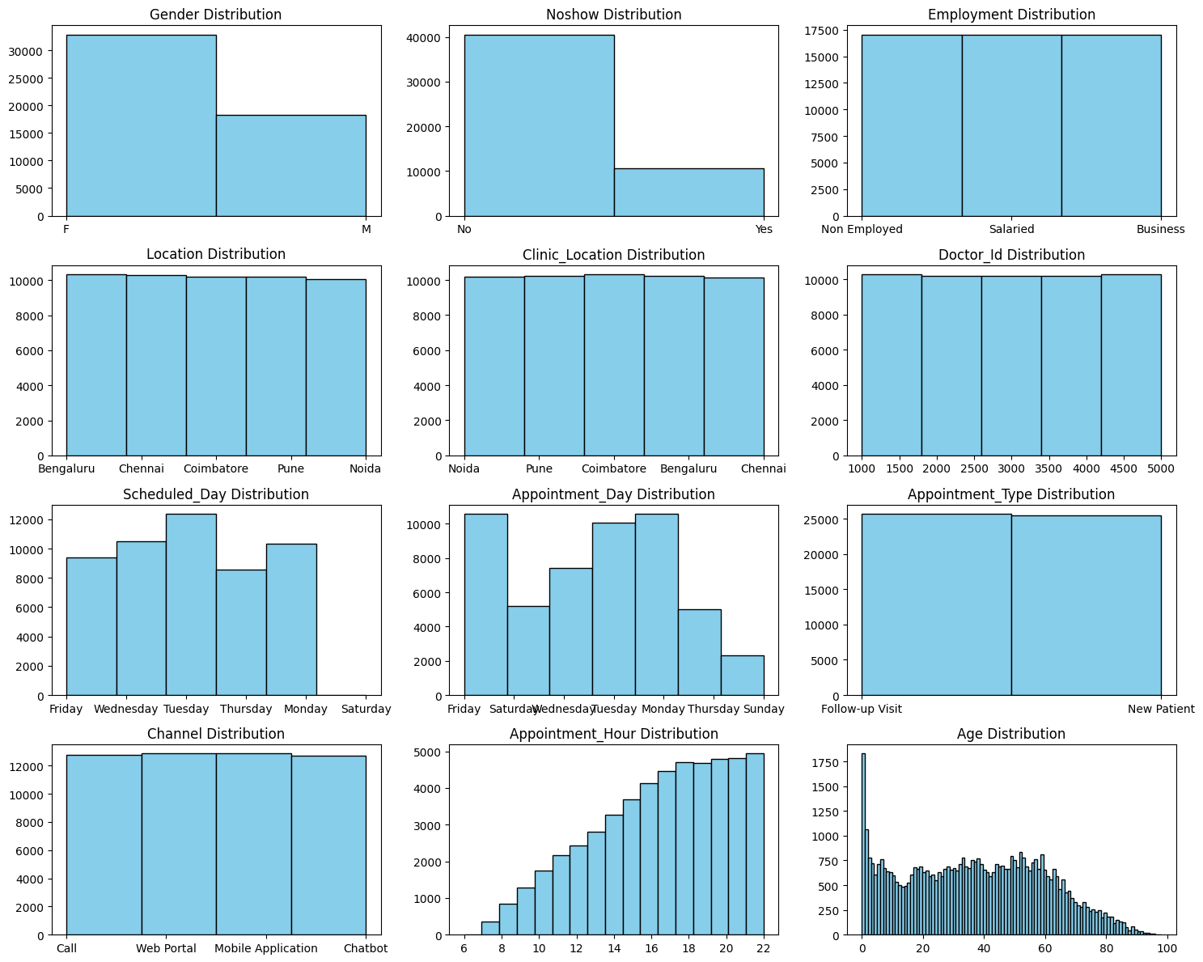
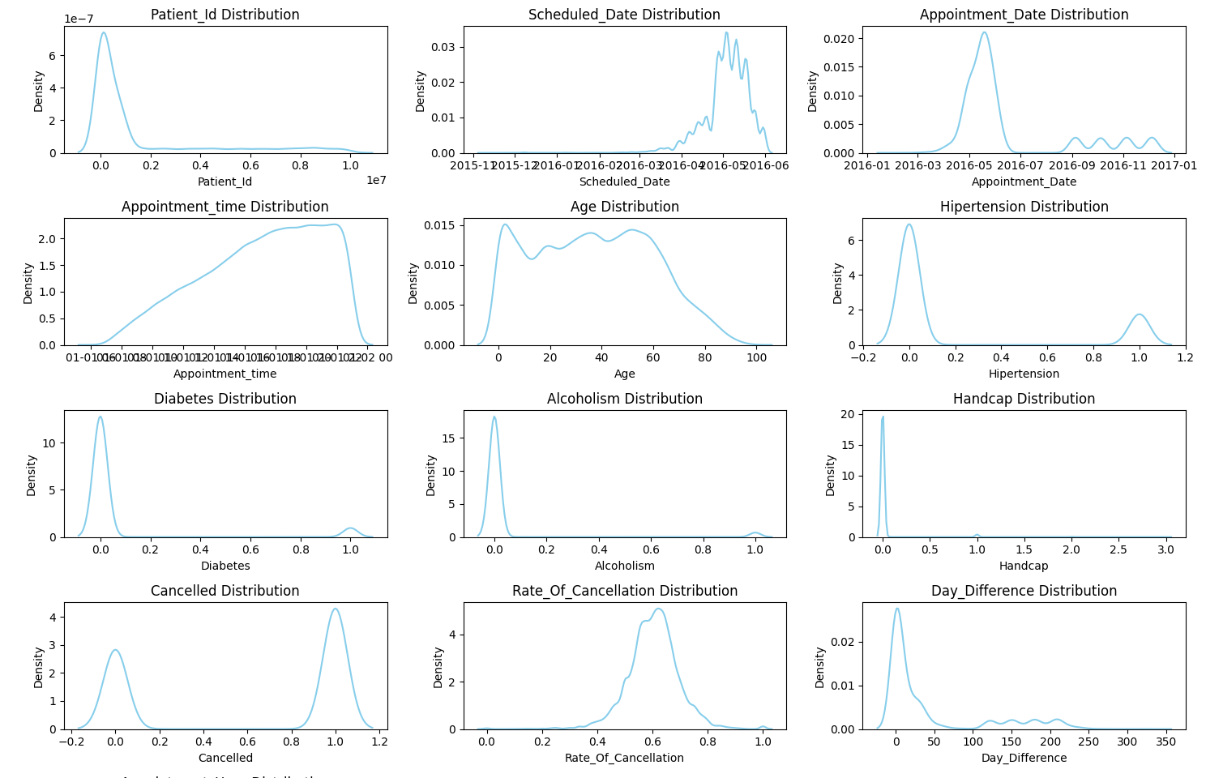
Exploratory Data Analysis:
Let us visualize the distribution of all columns

Slide 12
From the above, we can see that:
Gender is heavily skewed towards female, age has a massive spike in 0.
Appointments tend to be higher into the night, there are far more 'no' entries in no-show.
Follow ups are just as much as new visits, there are more appointments on Monday, Tuesday, and Friday.
Mean rate of cancellation is around 0.6, there are more cancelled appointments than non-cancelled ones.
Most people have very little difference between their scheduled appointment and actual appointment dates.
Very few of our patients have hypertension, and fewer have diabetes.
There seems to be a massive spike in appointments at 2016-5, which falls by 2016-7.

Slide 13
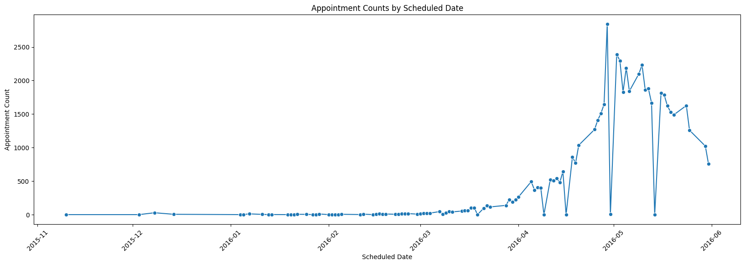
Here we can notice a gradual increase in appointments as April 2016 begins, with some falls that rise quickly. Towards the end of April, the appointments scheduled see a massive surge to reach its peak, but suddenly falls by the time May 2016 approaches, only to pick right back up. This can be explained by a clinic-wide holiday on May 1st, May Day. The high rate of appointments continues till mid may, where a similar plummet happens. But as June approaches, rates fall to mid-April levels.

Slide 14
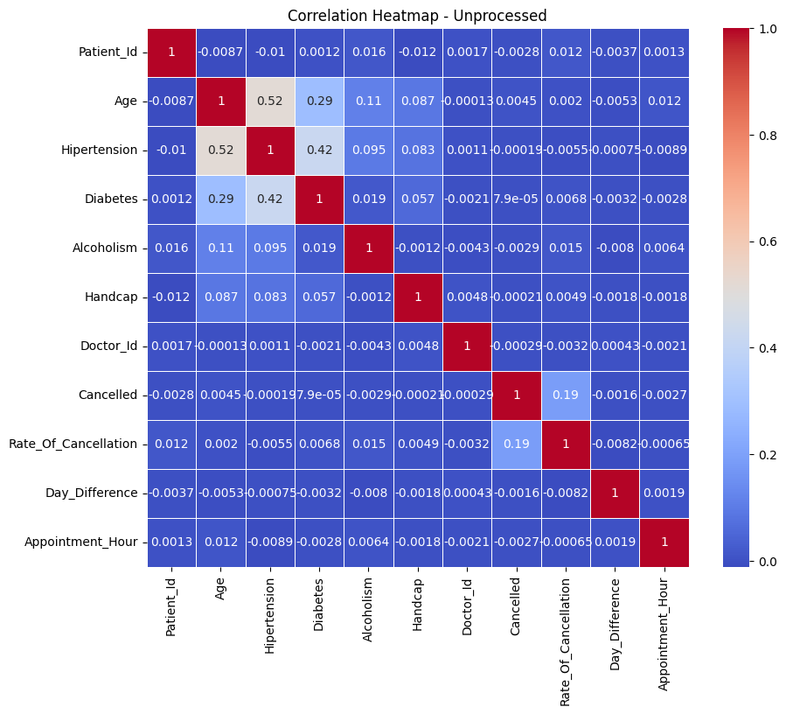
The above heatmap shows us that Hypertension and age has a medium correlation of 0.52. Hypertension and diabetes have a relatively weaker correlation of 0.42, and diabetes is weakly correlated with age, at a 0.29 coefficient. There is a weak correlation between rate of cancellation and cancelled appointments, meaning people with higher cancellation rates mildly tend to cancel appointments more. The lack of all variables indicates the need to transform the categorical variables for further analysis.

Slide 15
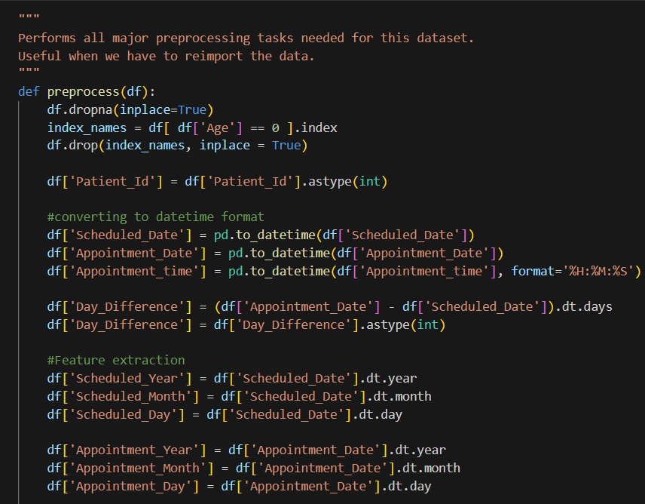
Preprocessing:
The following preprocessing tasks are done:
Dropping Null Values
Removing Zero Age Entries
Converting Data Type
Calculating Day Difference
Feature Extraction
Age Grouping
Feature Encoding
Removing Duplicates and Null Values
Correlation identification

Slide 16
Model Training, Testing and Validation:
- Data Preparation:
Features: All columns in the dataset except the target variable 'Noshow'.
Target variable: 'Noshow'.
- Models:
Random Forest
Gradient Boosting
XGBoost
Logistic Regression
Decision Tree
K-Nearest neighbours
Neural Network (MLP)
AdaBoost
- Techniques:
Undersampling (Random and ENN)
Oversampling (SMOTE)
Combination (ENN then SMOTE)

Slide 17
Combination (SMOTE then ENN)
Hyperparameter Tuning
Recursive Feature Elimination (RFE)
- Inferences and Results:
The choice of sampling techniques significantly impacts model performance.
The combination of SMOTE for oversampling followed by ENN for undersampling yielded the highest accuracy (89.48%).
Hyperparameter tuning improved model accuracy, with both Grid Search and Random Search providing competitive results.
Recursive Feature Elimination (RFE) helped identify and use the most relevant features for better model performance.

Slide 18
Task 2: Appointment time prediction

Slide 19
Appointment time prediction
Understanding the dataset:
Let us take a cursory glance at our dataset

Slide 20
From the above overview of the dataset, we can see that:
There are 23 columns and 51173 entries.
Most columns are non-numerical, non-ordinal and have no duplicates or null entries.
Mean age is 36, 20% of patients have hypertension, 6% have diabetes, and 3% have alcoholism.

Slide 21
Exploratory Data Analysis:
Let us visualize the distribution of all columns

Slide 22
From the above, we can see that:
Gender is heavily skewed towards female, age has a massive spike in 0.
Appointments tend to be higher into the night, there are far more 'no' entries in no-show.
Follow ups are just as much as new visits, there are more appointments on Monday, Tuesday, and Friday.
Mean rate of cancellation is around 0.6, there are more cancelled appointments than non-cancelled ones.
Most people have very little difference between their scheduled appointment and actual appointment dates.
Very few of our patients have hypertension, and fewer have diabetes.
There seems to be a massive spike in appointments at 2016-5, which falls by 2016-7.

Slide 23
Here we can notice a gradual increase in appointments as April 2016 begins, with some falls that rise quickly. Towards the end of April, the appointments scheduled see a massive surge to reach its peak, but suddenly falls by the time May 2016 approaches, only to pick right back up. This can be explained by a clinic-wide holiday on May 1st, May Day. The high rate of appointments continues till mid may, where a similar plummet happens. But as June approaches, rates fall to mid-April levels.

Slide 24
The above heatmap shows us that Hypertension and age has a medium correlation of 0.52. Hypertension and diabetes have a relatively weaker correlation of 0.42, and diabetes is weakly correlated with age, at a 0.29 coefficient. There is a weak correlation between rate of cancellation and cancelled appointments, meaning people with higher cancellation rates mildly tend to cancel appointments more. The lack of all variables indicates the need to transform the categorical variables for further analysis.

Slide 25
Preprocessing:
The following preprocessing tasks are done:
Dropping Null Values
Removing Zero Age Entries
Converting Data Types
Calculating Day Difference:
Feature Extraction
Age Grouping
Combining time
Feature Encoding
Removing Duplicates and Null Values:
Correlation identification

Slide 26
Model Training, Testing and Validation:
- Data Splitting:
Features (‘X’) are defined by dropping the 'Combined_Time' column, and the target variable (‘y’) is set to the 'Combined_Time' column.
The data is split into training and testing sets using the ‘train_test_split’ function, with 80% for training and 20% for testing.
- Model Initialization:
Various regression models are initialized, including Linear Regression, Random Forest Regressor, XGBoost Regressor, AdaBoost Regressor, Gradient Boosting Regressor, and Decision Tree Regressor.
- Model Evaluation:
Each model is trained on the training set and evaluated on the testing set.
Evaluation metrics include Mean Absolute Error (MAE), Root Mean Squared Error (RMSE), and R-squared (R2).
Results are printed for each model.
- Best Model Selection:
The best model is determined based on the model with the lowest RMSE on the testing set.
The best model name and its RMSE are printed.
- Weighted Model Training and Evaluation
Class Weights Computation: Class weights for the target column ‘y_train’ are computed using ‘class_weight.compute_sample_weight('balanced', y_train)’.

Slide 27
- Function for Training and Evaluating Models:
A function ‘train_and_evaluate_model’ is defined to train models with sample weights and evaluate them.
Sample weights are computed for predictions (‘y_pred’).
- Weighted Model Evaluation:
Each model is trained using the defined function, and results (RMSE, MAE, R2) are printed.
The best model is selected and compared against the best model overall
- Hyperparameter Tuning - Grid Search
Random Forest Regressor is used with a grid search to find the best hyperparameters.
Grid search parameters include the number of estimators, maximum depth, and minimum samples split.
The best hyperparameters are used to train a new Random Forest model.
- Hyperparameter Tuning - Random Search
Random Forest Regressor is used with a random search to find optimal hyperparameters.
Random search parameters are defined using distributions.

Slide 28
The best hyperparameters are used to train a new Random Forest model.
- Model Comparison and Selection
Results of grid search and random search are compared using a DataFrame (‘results_df’).
The DataFrame includes metrics for both grid and random search.
The overall best model is selected based on the lowest RMSE from grid and random search and compared against the best model overall
- Cross-Validation:
Models are evaluated using cross-validation with k=2 folds.
Metrics (RMSE, MAE, R2) are calculated for each model.
Results for each model are printed.
The best model is selected and compared against the best model overall.
In our case, the best model is Gradient Boosting Regressor with RMSE: 0.29.

Slide 29
Task 3: Stock Price Prediction

Slide 30
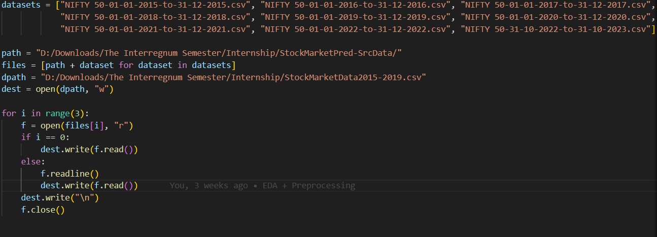
Stock Price Prediction
Understanding the dataset:
Context:
The dataset was provided as various CSV files, each containing the records of a year from 2015 to 2023. They were combined into 3 new CSV files: one from 2015-2019, one from 2019-2023 and one from 2015-2023. The overall structure of the dataset was not altered in this process. The columns were renamed for the sake of convenience, like so:

Slide 31
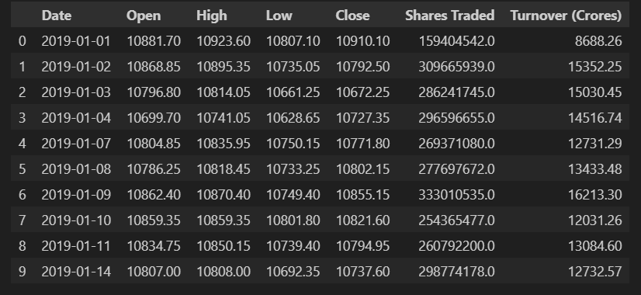
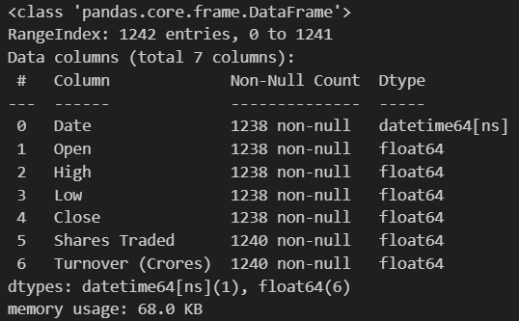
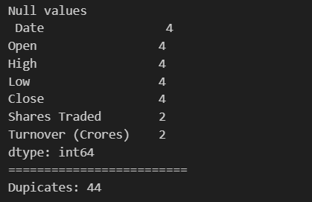
Let us take a cursory glance at our dataset
The dataset has 7 columns, namely ‘Date’, ‘Open’, ‘High’, ‘Low’, ‘Close’, ‘Shares Traded’, ‘Turnover (Crores)’. All columns have 12422 entries and are of ‘float64’ datatype, except for the ‘Date’ feature.

Slide 32
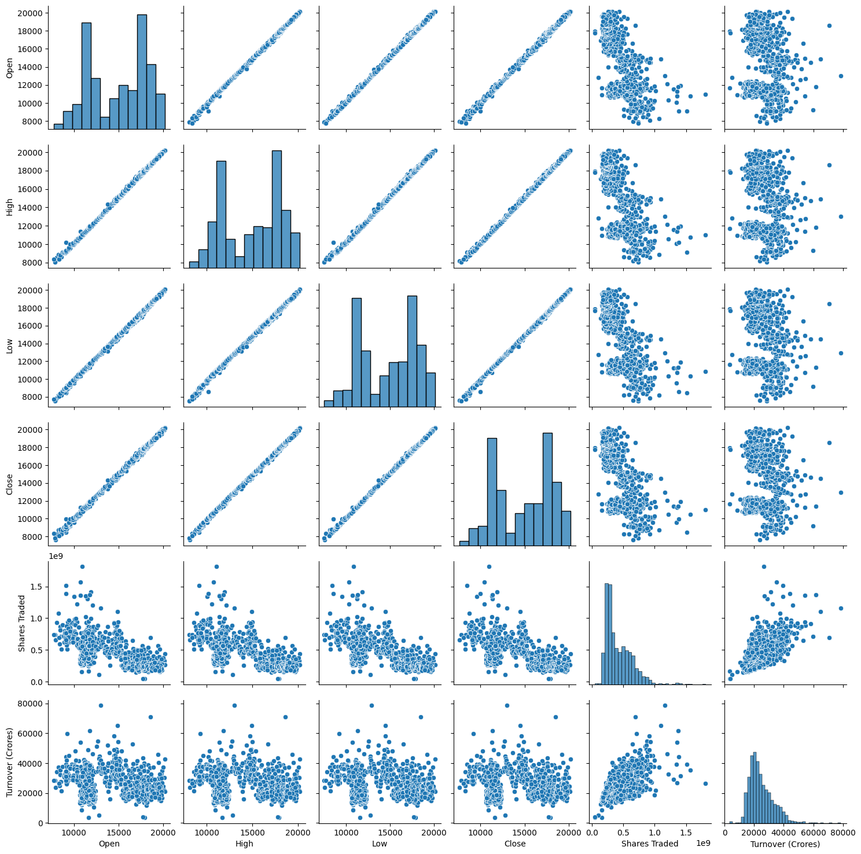
Exploratory Data Analysis:
Let us visualize the distribution of all columns
The pair plot reveals the pairwise relationships between numerical features in the dataset. Diagonal plots depict the distribution of each feature, while off-diagonal plots show scatter plots between feature pairs. Observations indicate strong positive correlations between ‘Open’, ‘High’, ‘Low’, and ‘Close’, indicating a consistent upward trend. A moderate positive correlation exists between ‘Shares Traded’ and ‘Turnover (₹ Cr)’, implying a rise in trading volume alongside an increase in total traded value. The weak positive correlation between Date and other features suggests an overall upward trend in stock prices over the past 5 years.

Slide 33
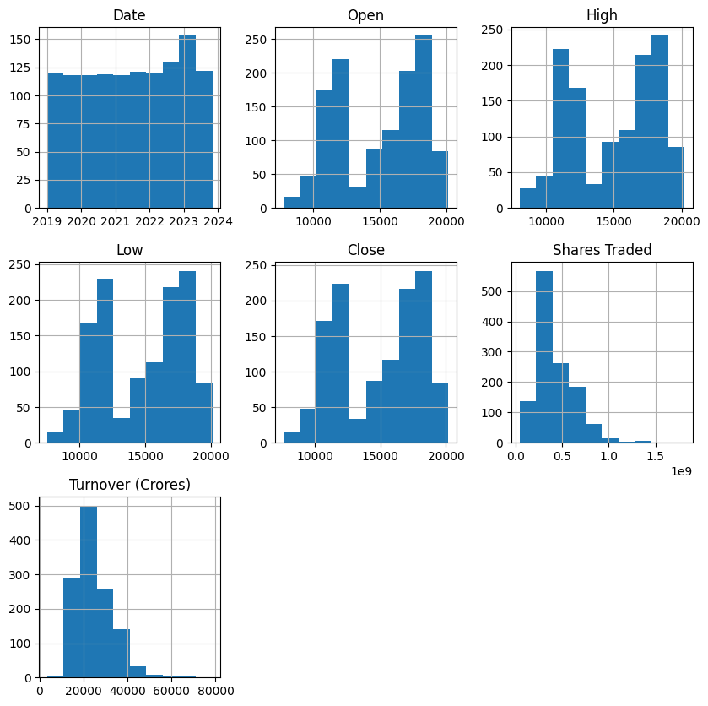
The histograms provide insights into the distribution of data across each column. The ‘Date’ column exhibits a uniform distribution across the entire range, indicating that the stock market data covers the entire 5-year period. The ‘Open’, ‘High’, ‘Low’, and ‘Close’ columns show similar distributions, with a peak in the middle and decreasing values towards the edges, suggesting a generally stable stock price with occasional fluctuations. The ‘Shares Traded’ and ‘Turnover (Crores)’ columns exhibit right-skewed distributions, with a few data points corresponding to very high trading volumes and turnover values, a typical characteristic of stock market data.

Slide 34
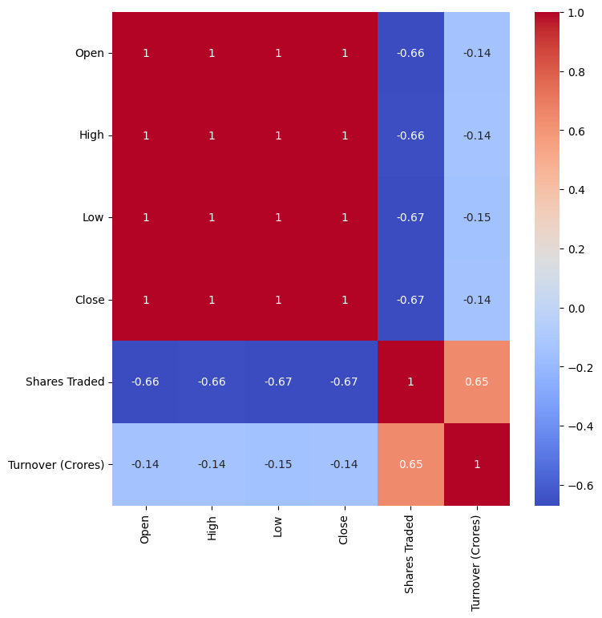
Observations reveal strong positive correlations between ‘Open’, ‘High’, ‘Low’, and ‘Close’, unsurprising given their relationship to the stock price. A moderate positive correlation exists between ‘Shares Traded’ and ‘Turnover (₹ Cr)’, suggesting an increase in trading volume alongside a rise in total traded value. A weak positive correlation between Date and other features indicates an overall upward trend in stock prices over the past 5 years.

Slide 35
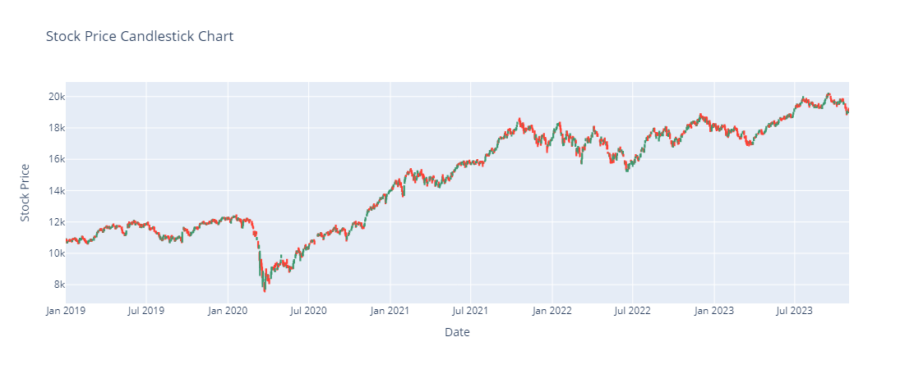
This candlestick chart suggests that there has been an overall growth of the stock across the observed time period, with a significant dip around March 2020, which is explained by the start of the Covid-19 pandemic, after that initial fall, recovery has been immense, reaching an all-time high as early as late 2020, after which growth continued to accelerate, with occasional, but temporary drops.

Slide 36
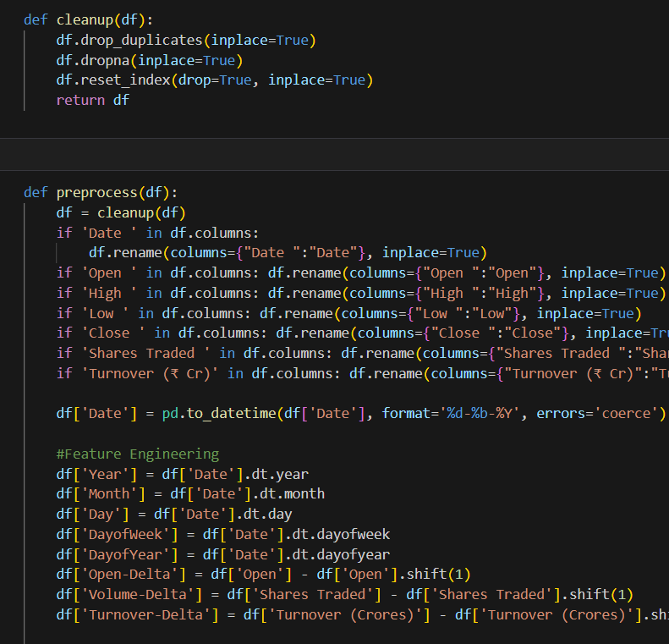
Preprocessing:
These are the tasks done in the preprocessing phase:
Cleanup
Column Renaming
Date Conversion
Feature Engineering
Percentage Change
Moving Averages
Data Cleaning
Feature Selection

Slide 37
Model Training, Testing and Validation:
Setup:
Utilizes MinMaxScaler from sklearn for data normalization.
Splits the dataset into features (X) and target variables (y).
Applies MinMax scaling to both X and y.
Data Splitting:
Splits the data into training and testing sets using train_test_split from sklearn.
X: all features except 'High', 'Low', 'Close'; Y: 'High', 'Low', 'Close'
Prints the shape of X_train, y_train, X_test, and y_test.
Model Evaluation - Direct Training:
Utilizes various regression models (Random Forest, Gradient Boosting, K Nearest neighbours, Linear Regression, XGB, AdaBoost, MultiTaskElasticNet).
Trains each model on the training set and evaluates performance on the testing set.
Prints metrics such as Mean Absolute Error (MAE), Root Mean Squared Error (RMSE), and R-squared for each model.
Displays the original and predicted values for the first five samples.
Selects the best-performing model based on RMSE.
Best Performing Model: Linear Regression with RMSE: 0.01

Slide 38
Hyperparameter Tuning:
Utilizes GridSearchCV to search for the best hyperparameters for each model.
Re-evaluates model performance on the testing set using the tuned hyperparameters.
Prints metrics and displays the original and predicted values for the first five samples.
Selects the best-performing model based on RMSE after hyperparameter tuning.
Best performing model: Random Forest Regressor - MAE: 0.01, RMSE: 0.01, R-squared: 1.00
Cross Validation:
For each model, cross-validation is performed with 2 folds (‘cv=2’).
Evaluation metrics include:
Root Mean Squared Error (RMSE): A measure of the average deviation of predicted values from actual values.
Mean Absolute Error (MAE): The average absolute differences between predicted and actual values.
R-squared (R2): A measure of the proportion of the variance in the dependent variable that is predictable from the independent variables.
Best performing model: Linear Regression - RMSE: 0.29, MAE: -0.25, R-squared: 0.99
- The best model overall is Linear Regression with RMSE: 0.01

Slide 39
Model Deployment

Slide 40
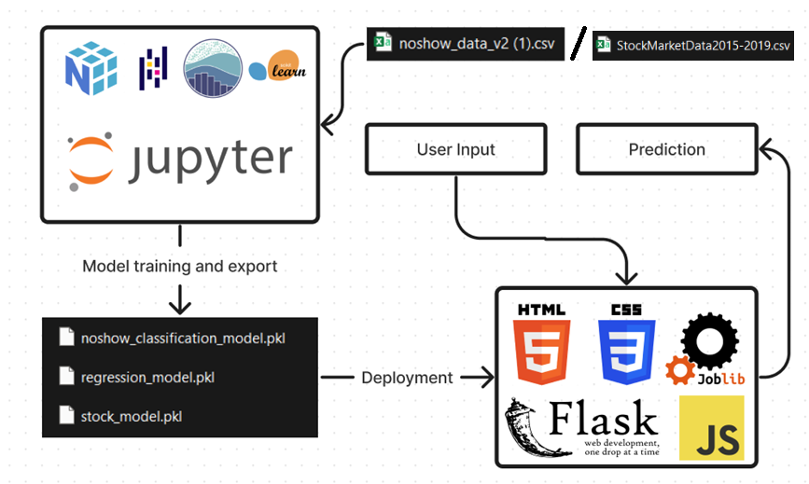
Model deployment - Overview
All three models were deployed under a single user interface using flask, HTML and CSS. The models were exported using Joblib.

Slide 41
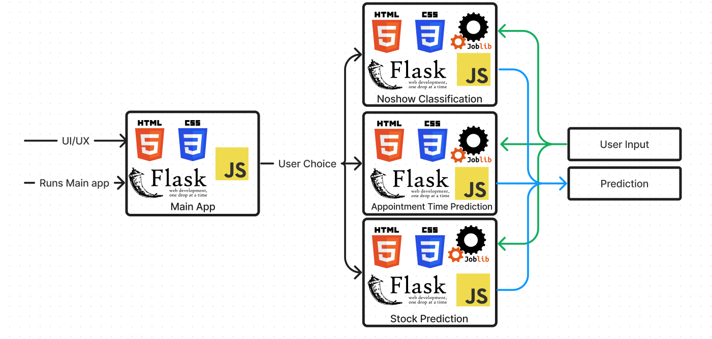
The project is initialized by running the main_app.py file, which uses the index.html file as a template to render the model selection screen. Upon selecting the model required, it loads the associated flask file, with its relevant HTML, CSS and PKL files. The user prediction is taken by the HTML file and sent to the flask file, where the prediction is calculated and sent back to the HTML file to be rendered to the user.

Slide 42

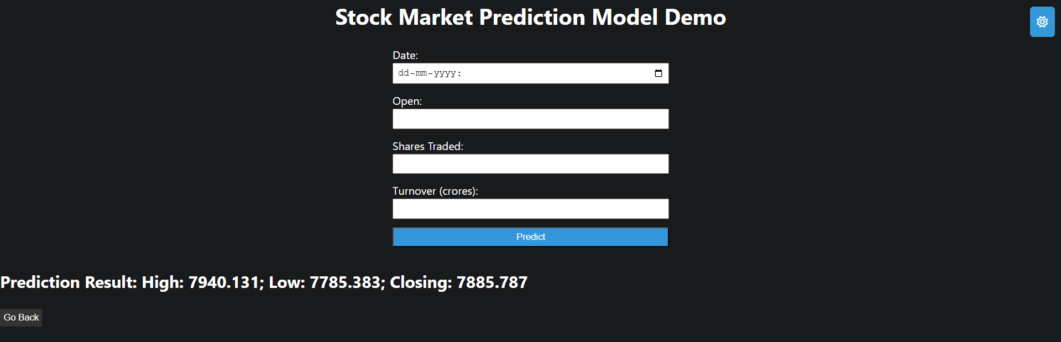

Slide 43
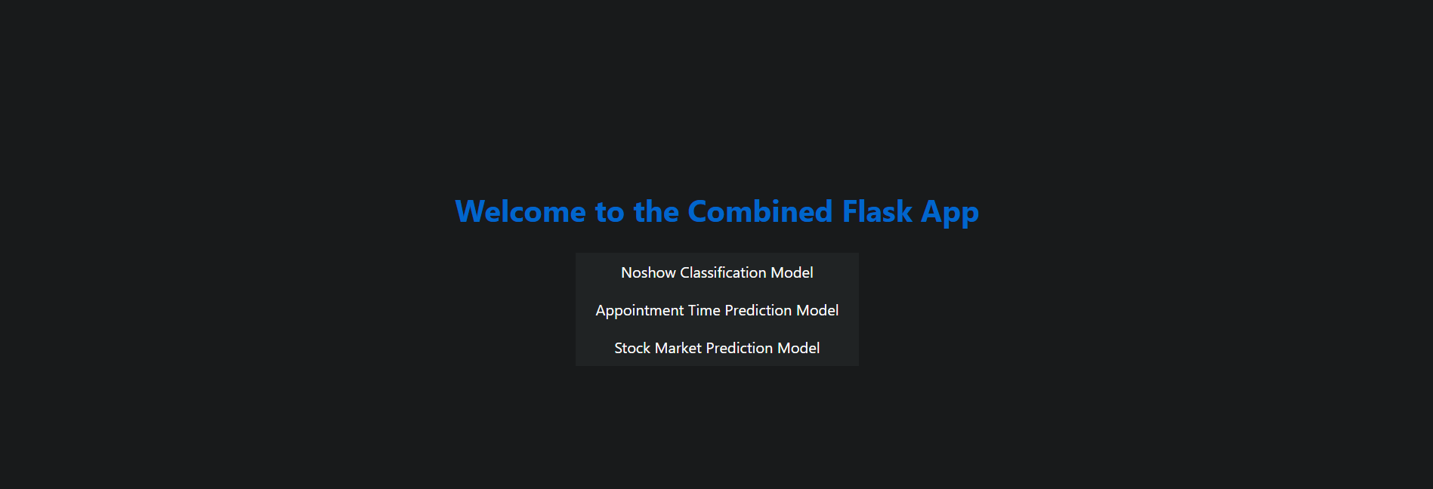

Screenshots

Slide 44
Challenges and limitations
No Improvements past a threshold: In the regression tasks, accuracy do not improve past a specific threshold (e.g., 10 points for the stock prediction model). This is likely since the dataset is limited to the trends within the given date range and thus the patterns do not carry over outside of it. For example, the Covid-19 Pandemic drastically increased clinic visits and greatly varied the stock market.
Similarity in accuracy among models still led to varying predictions when practically tested. This is probably due to the inherent differences in the assumptions the algorithms take to predicting the answer, since the difference is not very significant.
Class imbalances in the dataset (specifically the noshow dataset) led to very inaccurate results in the beginning. However, using resampling techniques greatly helped with the accuracy of the prediction. Here is the result of the K-Nearest neighbours model before resampling

Slide 45
Here is the result of the K-Nearest neighbours model before resampling
Here is the result after applying SMOTE-ENN resampling
In the Stock prediction model, unscaled predictions led to drastic levels of error in the predictions. However, after adding a MinMaxScaler, the predictions became much more accurate.
Because of the drastic changes to the stock market during the Covid 19 pandemic, using data from 2019-2023 drastically varies predicted values. If the models are trained and tested on pre-pandemic data, the error range is halved.

Slide 46
Scope for improvement
Using Deep learning models to predict values can lead to better results
The user interface is barebones and can use more quality-of-life improvements
Trying time series prediction to improve validation, however that decreases recall values
Using SHAP values for tree-based models to interpret the feature importance.

Slide 47
Learnings and Takeaways:
Machine Learning Workflow:
Classification and regression workflows
Exploratory Data Analysis (EDA)
Data preprocessing and resampling
Model Deployment and UI/UX:
Deployment with Flask
Basic UI/UX design
Integration of HTML, CSS, and JS
Data Handling:
Data extraction and standardization
Identifying crucial features
Analysing feature importance
Adjusting data for imperfections
Model Selection:
Choosing the right model for the task
Results Presentation:
Presenting results in a user-readable format

Slide 48
Problem Solving Process:
Formulating a structured problem-solving process
Understanding and analysing problem-related information
Inference and Communication:
Deriving inferences from information
Communicating answers comprehensibly
Problem Resolution:
Approaching difficulties and resolving them
Information Management:
Retaining useful findings
Discarding irrelevant information
Effective Communication:
Communicating answers comprehensibly

Slide 49
conclusion
This internship has helped me learn the intricacies of machine learning and Data Science in a practical and corporate setting. It has allowed me to use my theoretical knowledge to create and deploy models of practical use-cases. It has also helped me learn the frameworks and tools around deployment of ML models.

Slide 50
THANK YOU
Ananth T A
ananthta2004@gmail.com

